Slide 1

SILICON STADIUM
HELLO WORLD OR BUST

Slide 2

DESCRIPTION
Our app is a web based statistic analysis tool
Provides users with accurate predictions of NFL games
Past 20 years of NFL data
Injury analysis
Up to date weather data
Notes:
provide insights

Slide 3
FRONT END SYSTEM
Website design
Representing data graphically
UI/UX planning
Languages involved (HTML, CSS, Javascript, PHP)
Development (Visual Studio Code)

Slide 4
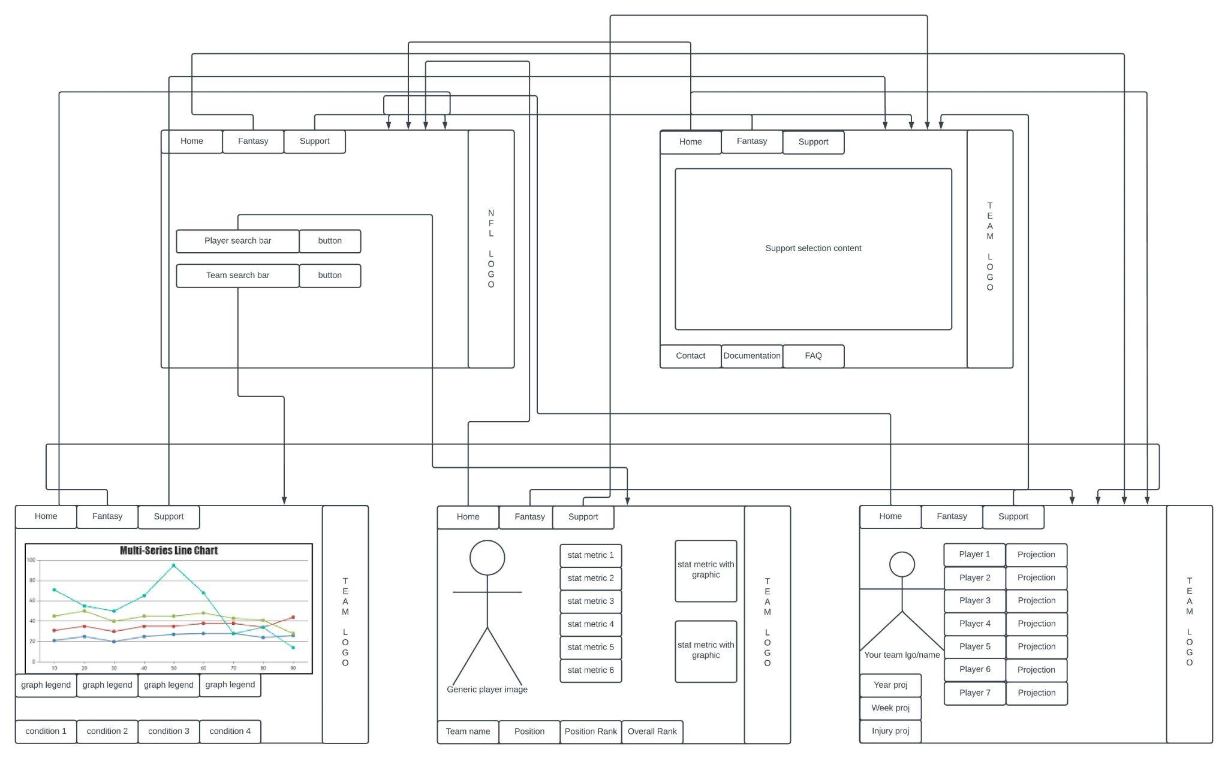
Web application Layout

Slide 5
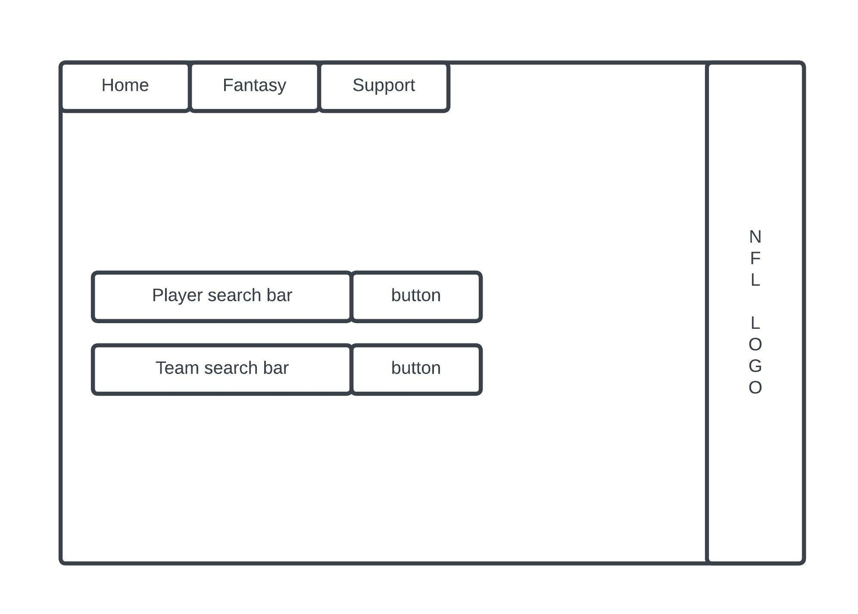
Home Screen

Slide 6
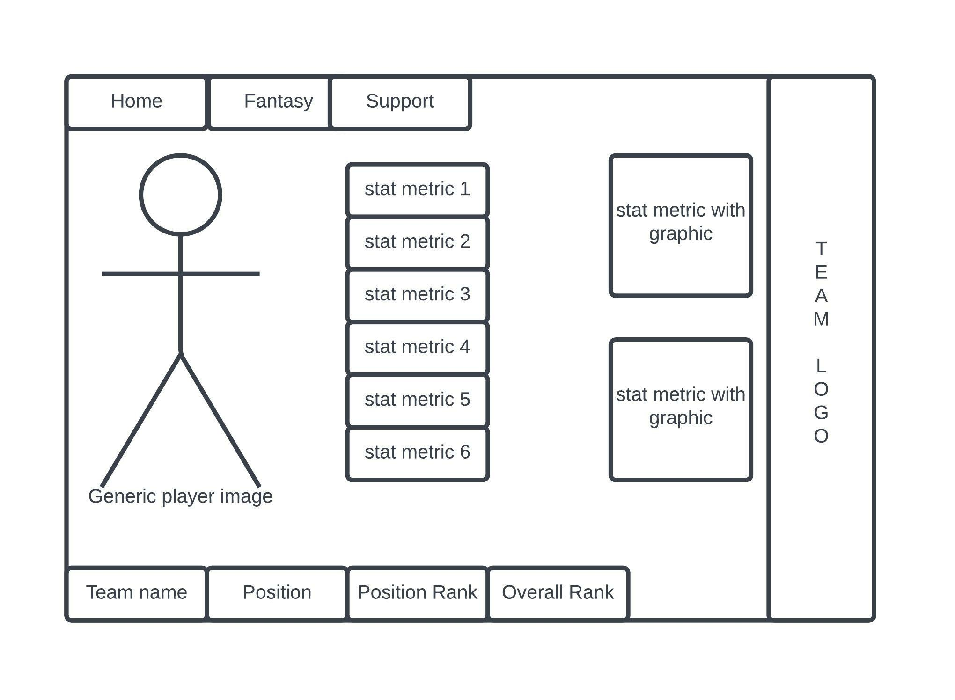
Players Screen

Slide 7
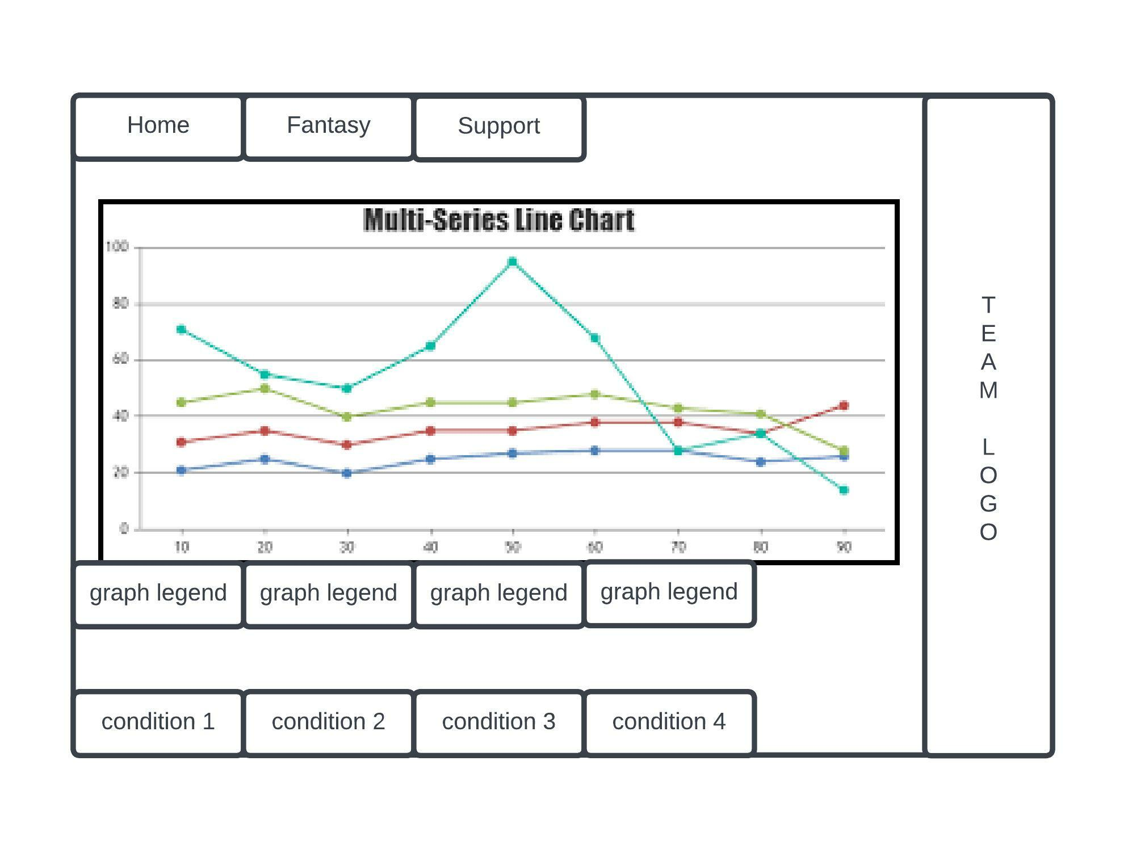
Teams Screen

Slide 8
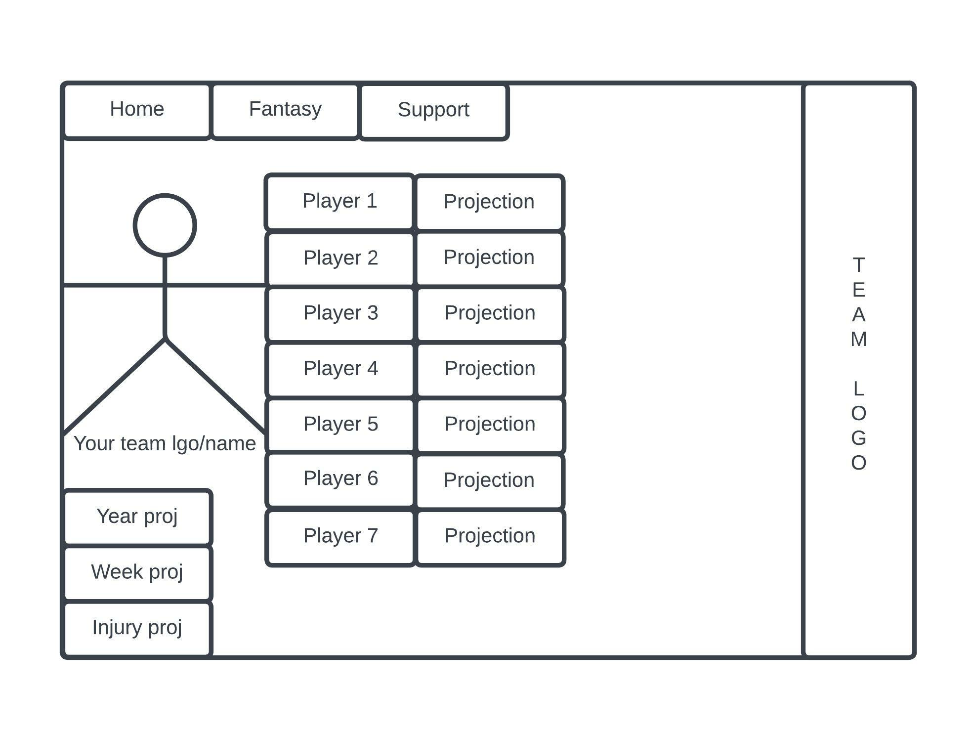
Fantasy Screen

Slide 9
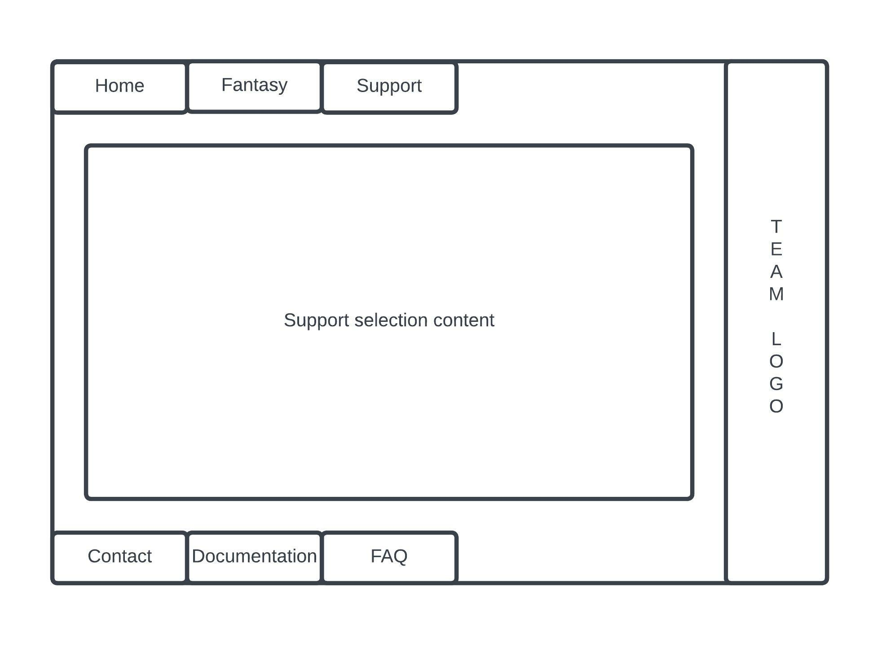
Support Screen

Slide 10
DATABASE
Consists of 3-4 major tables
Each major table has at least 1 subtable within, more if we decide to split the data more
There will also be a large storage table for all the machine learning data sent back
Run through a mySQL database and through XAMPP
Data inputted through SQL files converted from CSV files
CSV files stripped down and cleaned to produce good data to be put into the database
This data will produce the tables and subtables

Slide 11
SECURITY
Two potential security breach locations
In the main page search bars
Runs the risk of possible SQL injections
In the connection between each aspect of the application
From the front end website to the database
From the database to the machine learning algorithm
From the machine learning algorithm to the front end website

Slide 12
NEURAL NETWORK
Convolutional Neural Network
Prediction of scores
Initially plan for predicting score
Later add a filter to only output possible scores.
Requirement: 70% accuracy or better

Slide 13



Project Specifications
Aside from the libraries that are specifically for machine learning, numpy and pandas will be used for more general statistical analysis. More simple yet important statistics such as points per game don’t need to be fed to the neural network.

Slide 14


Data Sources
While Kaggle datasets have a lot of historical data that we are planning to use to experiment with which parameters are important. ASA has the most up to date data in the last 4 years.

Slide 15

Thank You
Notes:
currently figuring out how to implement our backend code

